Slide 1
Clean Architecture
Notes:
Whos heard of clean architecture?
Hexagonal architecture?

Slide 2
Agenda
What is clean architecture
Layering
Problems with some layered system and how to solve them
What practices does clean architecture pair well with
Building your own best practice

Slide 3
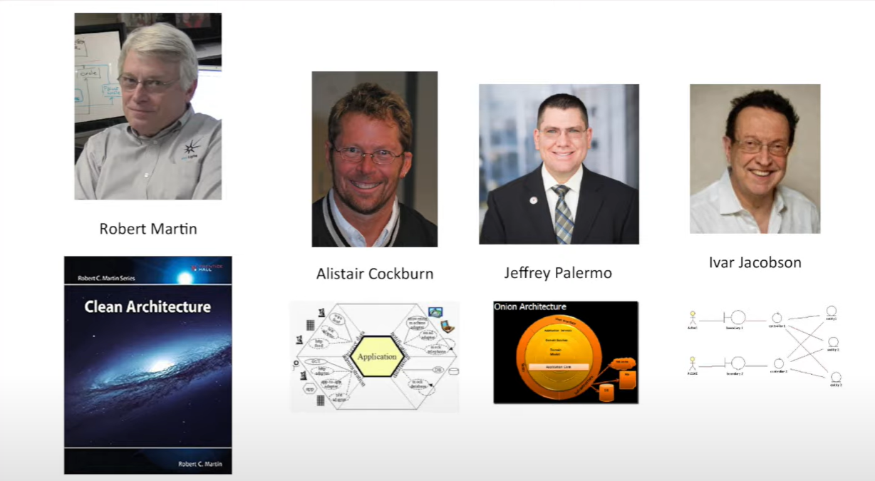
What is the clean architecture
Notes:
Robert Martin coined the term its in his excellent book clean architecture
Alister Cockburn created what he called the hexagonal architecture because his diagram was a hexagon
Jeffrey Palermo Created onion architecture and Ivar jackbson created boundaries controllers and entities
All were talking to the same concerns.

Slide 4
Layering
Notes:
Who here would say they have a layered system
Who would say that is a good thing?

Slide 5

Layering
UI
Business
Data Access
Database Other INF
Notes:
We separate code into these distinct layers
People often used to call the bottom layer the data layer because it was concerned with the database alone but its really any out of bound dependency, http cache etc
Each layer has a public interface for the layer above.
The calls go down you can't have cycles.

Slide 6
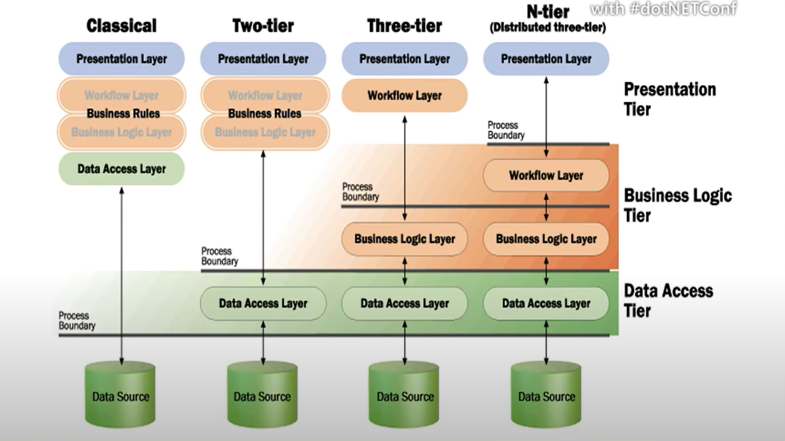
Notes:
Not a new thing this is a Microsoft slide from 2001
Also don’t think that it was ever meant to be 3 layers that is just a convention

Slide 7
What's good about layers
Don’t worry about implementation details
Swap out implementations in a layer
You can defer decisions about layers to the last minute
Reduce dependencies
Coupling is bad
Coherence is good

Slide 8
Layering
UI
UI
Infrastructure (inc data access)
Database Other INF
Domain Business
Business
Infrastructure
Database Other INF
Notes:
In clean architecture we make the domain the centre of our application all

Slide 9
How this is often implemented
UI
Application
Domain
Infrastructure
Database Other INF
Notes:
We just split the business logic into two layers
However we often don’t really model the domain
Domain just ends up being bags of data with no behaviour

Slide 10
Two types of business logic
Domain Logic this tends to be the rules of our business
Application Logic what does the application do to make it work (sometimes called workflow logic)
Notes:
Banking system what are the rules that decide if I give you a load or not
Application logic maybe get some existing details about the custom from persistence run some domain logic save some change send a response.

Slide 11
Two common implementations
Domain facade a thin wrapper of application logic around core domain logic
Operation scripts we don’t have much of a domain for this action, so we just implement the very simple logic in our application layer
People often do one when they should do the other.
Notes:
People sometimes try and crowbar a domain around application that are too simple they don’t warrant the complexity DDD is not for everything
Often when we do have a complex domain the entities in our domain are weak and don’t have any behavior and complex domain behavior is modelled in a set of large complex transition scripts

Slide 12
Clean Architecture
A domain centric approach

Slide 13
Ports and adapters
Defines the separations and responsibilities of layers
Application contains the rules of our application
Adapters abstract the inputs and out of our application
Ports converts between an actor via the adapter and the domain model

Slide 14
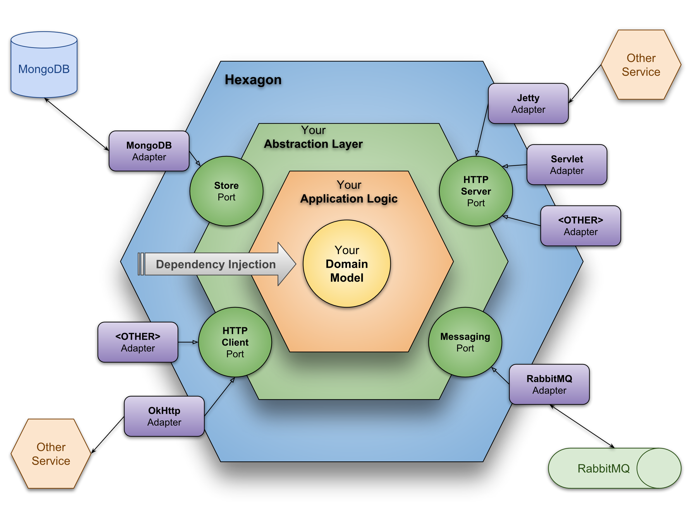
Notes:
The domain is at the heart everything depends inwards
In effect infrastructure and UI live in the same layer on the outside of the system and we access them via ports
So how would we ever save anything (in the old layered model the domain layer would persist changes)

Slide 15
Clean Architecture Rules
Model all business logic in the domain
All dependencies flow towards core
Interfaces are defined in the business logic domain/application
Notes:
You could duplicate validation logic for responsiveness

Slide 16
Clean Architecture
A
UI
HTTP API
GRPC
Events
Infrastructure
Bus
Adapters
Cache
Application Layer
Database
Business Logic
Domain Layer
Other Service
Notes:
How do lower layers depend on layers above = interfaces dependency inversion
This means

Slide 17
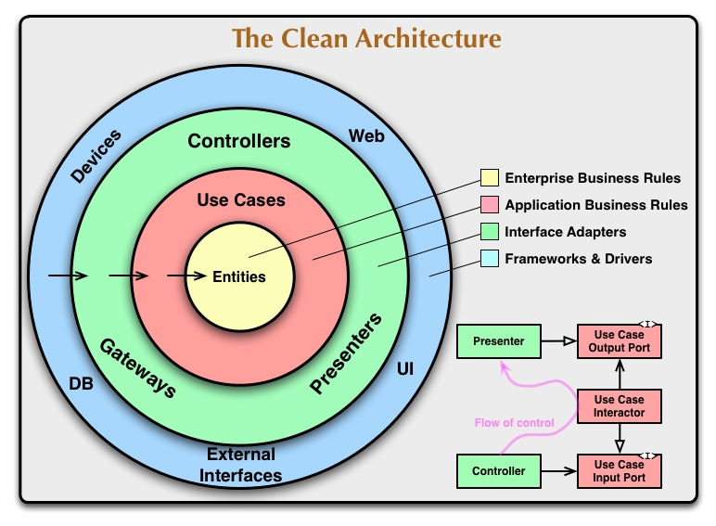

Slide 18
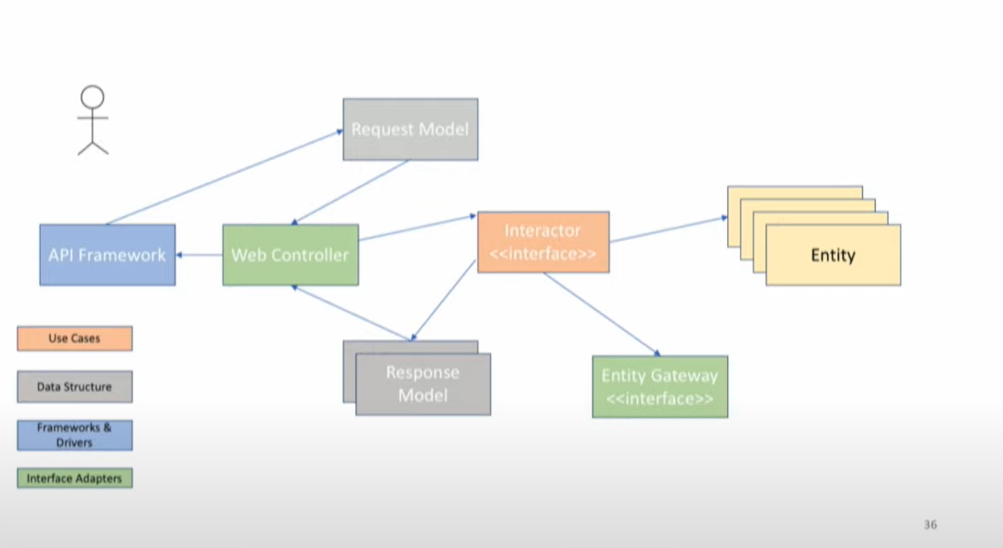

Slide 19
Some issues with implementing it
Notes:
These are not issues with layering its an issue with how people implemented that feature

Slide 20
Some issues with implementing it
Interface segregation
Phat services

Slide 21
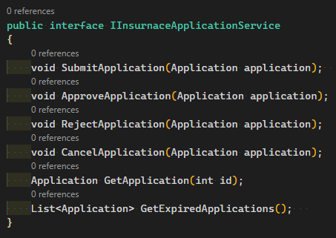
Problem: Phat service
Notes:
Has anyone seen code that looks like this?
This is where we group all the actions we can take on a given entity or aggregate into a single business logic service.
This break the interface segregate principle because I may only care about one of these methods
This means that anything that implements this interface must change when any one of these responsibilities change
It means we have no common interface signature for the ports in our system every method signature is different this can make it hard for us to add cross cutting concerns.

Slide 22
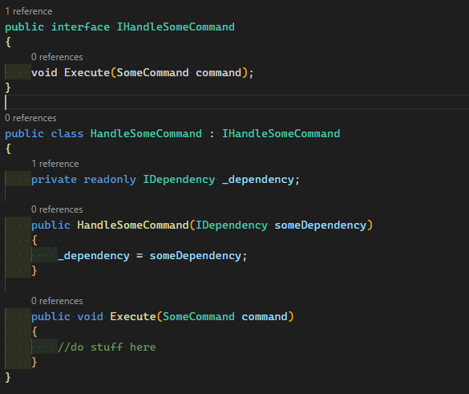
Fix: Command Dispatcher
Commands become your ports into the application
This can be useful as you can setup pipelines
Don’t confuse this with CQRS

Slide 23
Some issues with implementing it
Function grouping of code
Notes:
This is not an architectural issue but more about how easy it is to navigate code bases.

Slide 24
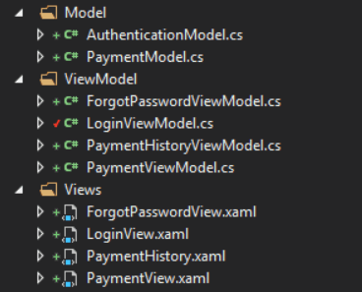
Problem: Grouping code by function

Slide 25
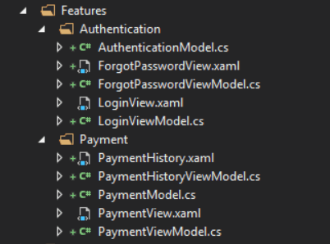
Fix: Feature Folders
Notes:
This should be reflected at every level of the program

Slide 26
Fix Slice By Feature
Feature
UI
We have this feature slide through our layers
When we change the code for rejecting insurance application in should only effect one slice of the system
Application
Domain
Infrastructure
Random INF

Slide 27
Some issues with implementing it
Weak domain models
Notes:
These are not issues with layering its an issue with how people implemented that feature

Slide 28
Fix: Rich domain model
DDD is a big topic we wont get into here

Slide 29
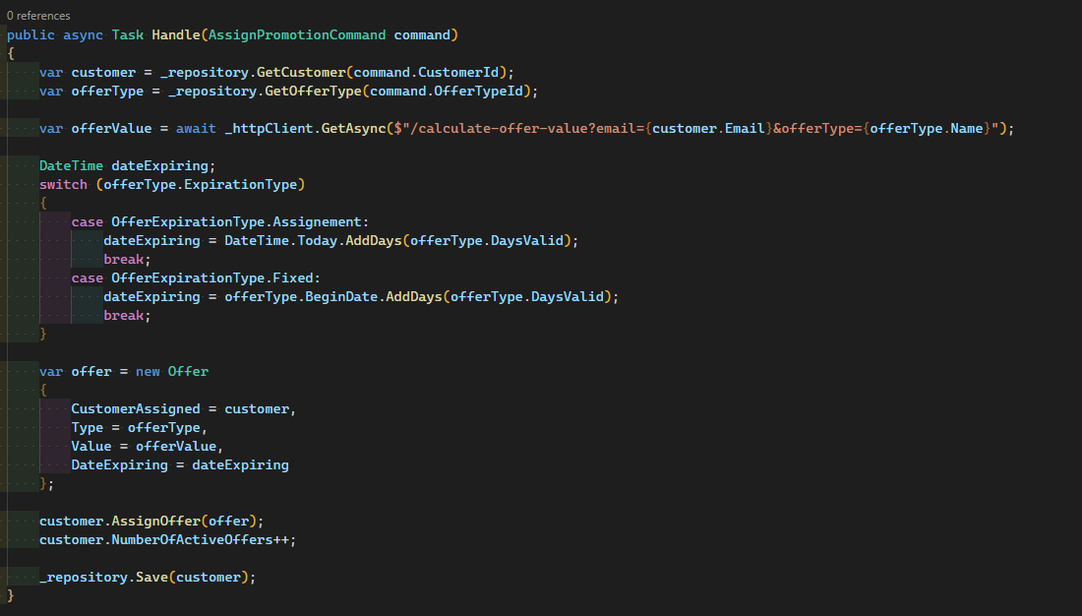
Problem: Weak domain model
Notes:
Weak domain model. The red flag is entities that have state but no behavior

Slide 30
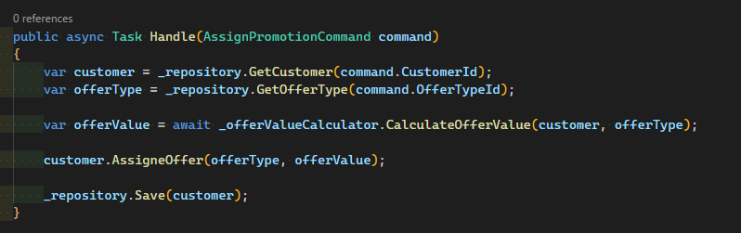
Fix: Rich domain model

Slide 31
Some issues with implementing it
Interface segregation
Phat services
Grouping code by type not behavior
Models became database we just copied the model up the layers without thinking
No common interface for requests
Notes:
These are not issues with layering its an issue with how people implemented that feature

Slide 32
Problem: No common interface
How do we support cross cutting concerns.

Slide 33
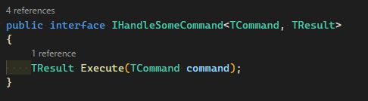
Fix: Command Dispatcher / Mediator Pattern

Slide 34
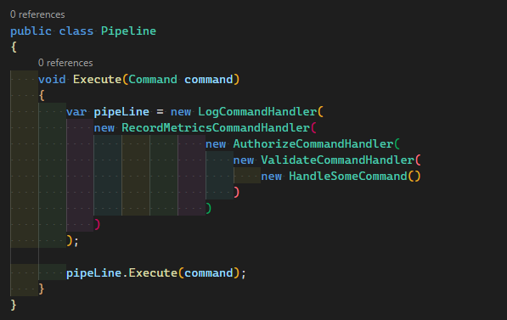
Fix: Command Dispatcher / Mediator Pattern

Slide 35
Some issues with implementing it
Functionality tied to hosting model
Notes:
These are not issues with layering its an issue with how people implemented that feature

Slide 36
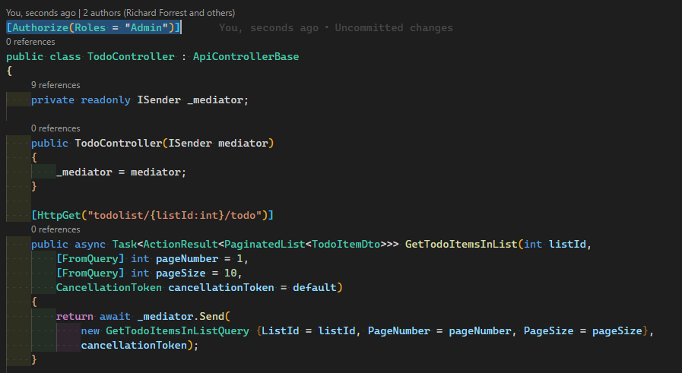
Problem: Business logic tied to adapter

Slide 37
Fix: Dumb Ports
Make sure that business logic is not tied to your adapter implementation

Slide 38
Solution Structure

Slide 39
Exemplum
https://github.com/ForrestTech/Exemplum
https://www.nuget.org/packages/Exemplum.Template
`dotnet new -i Exemplum.Template`

Slide 40
Notes on shared code
Its possible to share both contracts and simple function logic
Shared kernel, the shared kernel should never have any dependencies
Beware Contracts and Client packages

